Slide 1
YOUR STATIONERY EQUIPMENT IS FROM US

Slide 2
YOUR STATIONERY EQUIPMENT IS FROM US
Time : October 2014-January 2015
The school provided with stationery equipments : Şırnak Cizre Primary School
The name of the equipment : Stationery Equipment

Slide 3
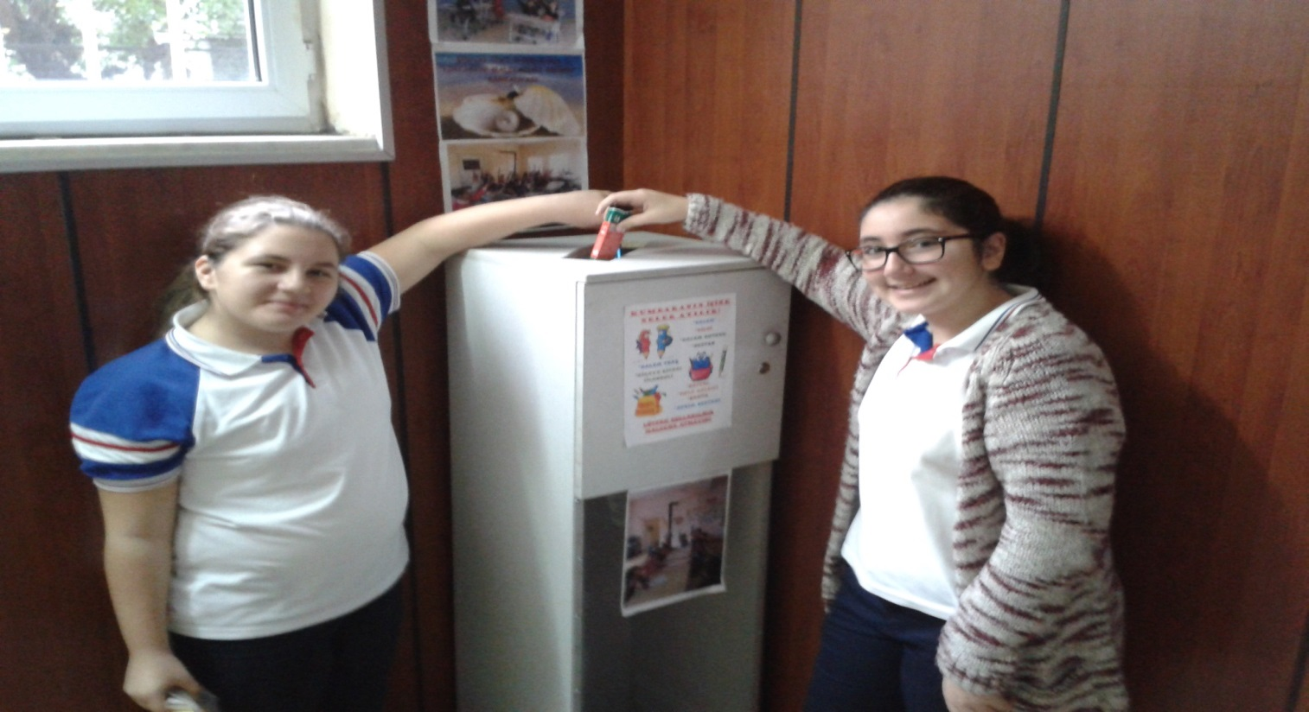
In our school, we announced our campaign and put a box for the stationery materials brought by our children.

Slide 4
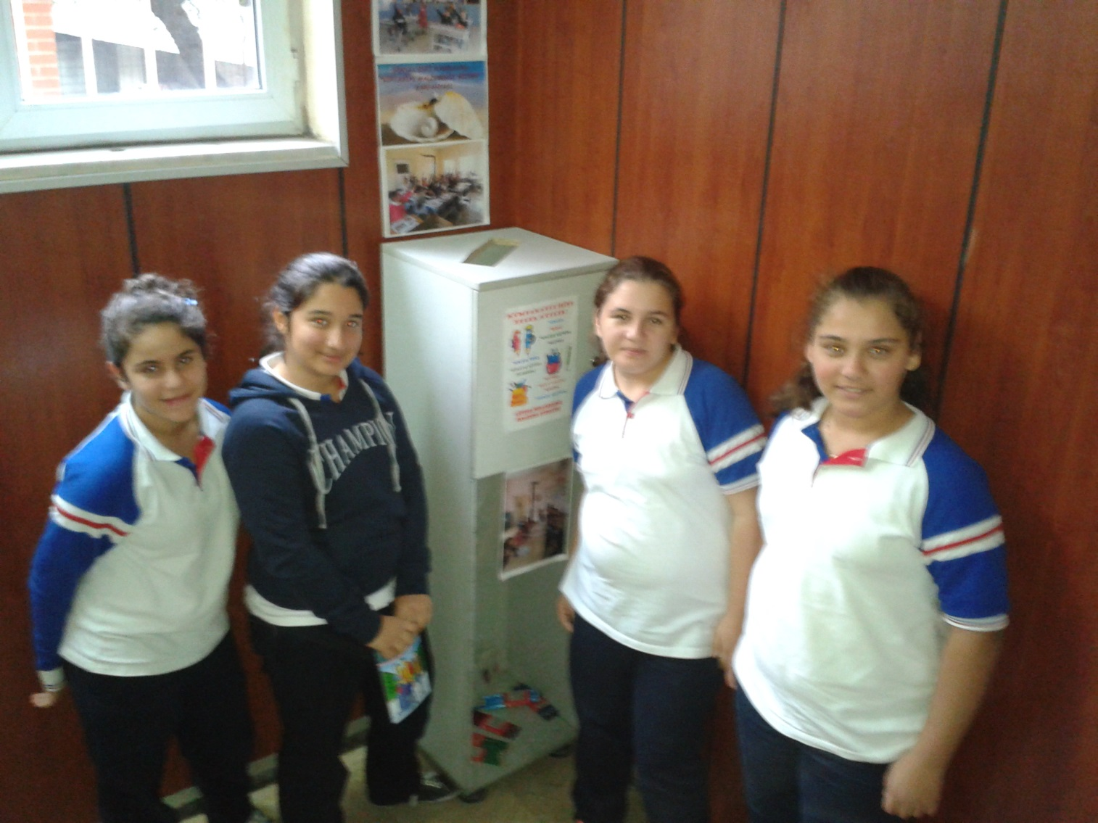
We had some responsible students who check the box in regular periods

Slide 5
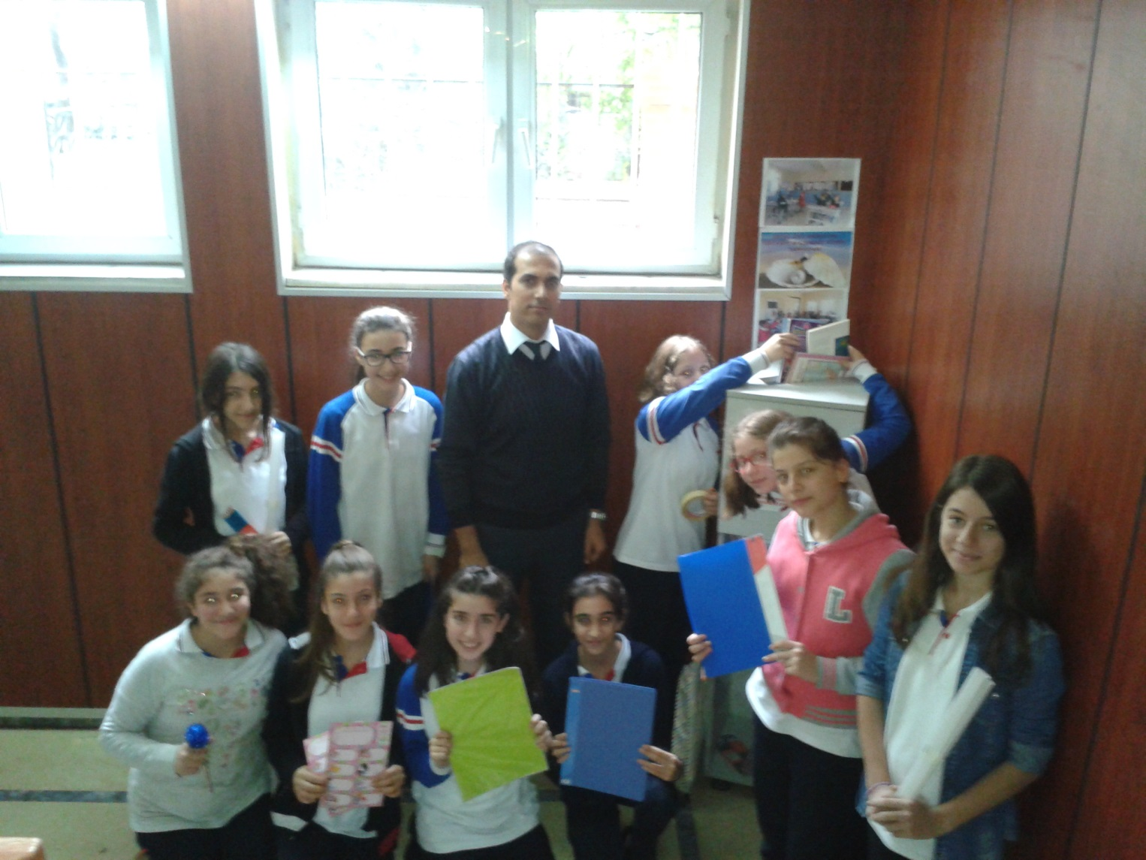
Students brought various kinds of materials such as story books, notebooks, file folders, pencils, crayons, scissors, stickers, schoolbags

Slide 6
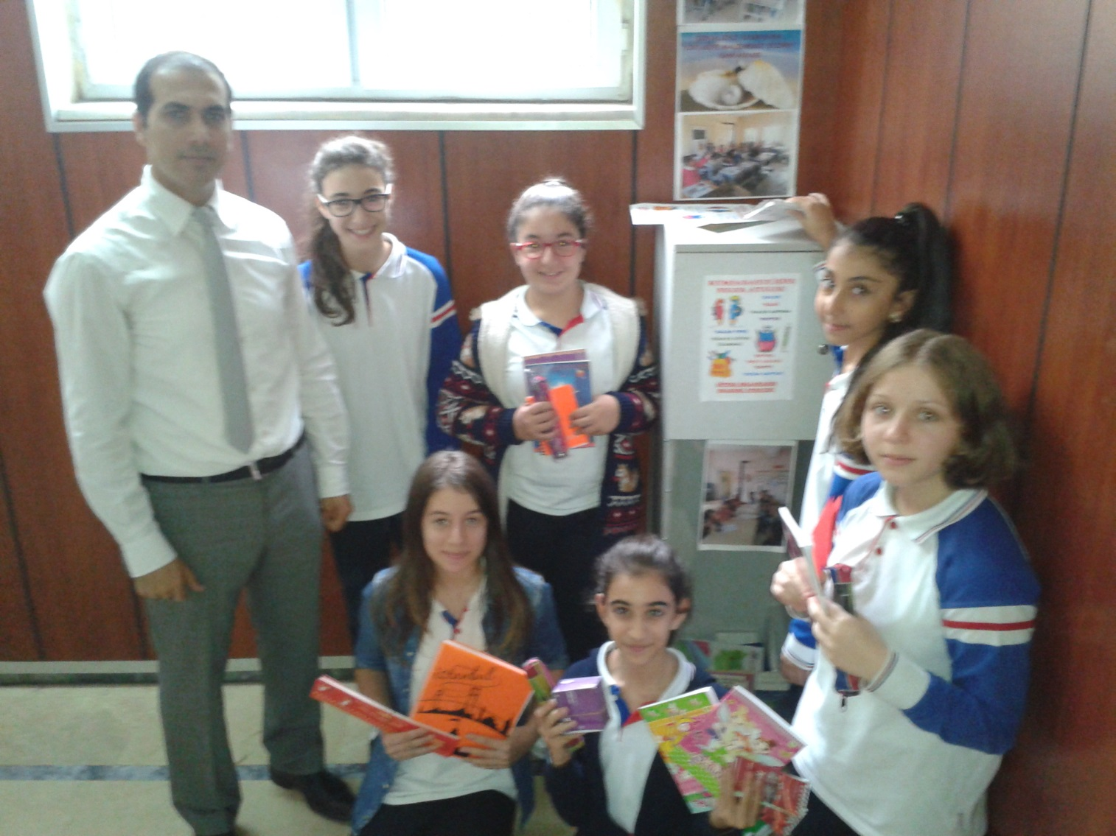

Slide 7
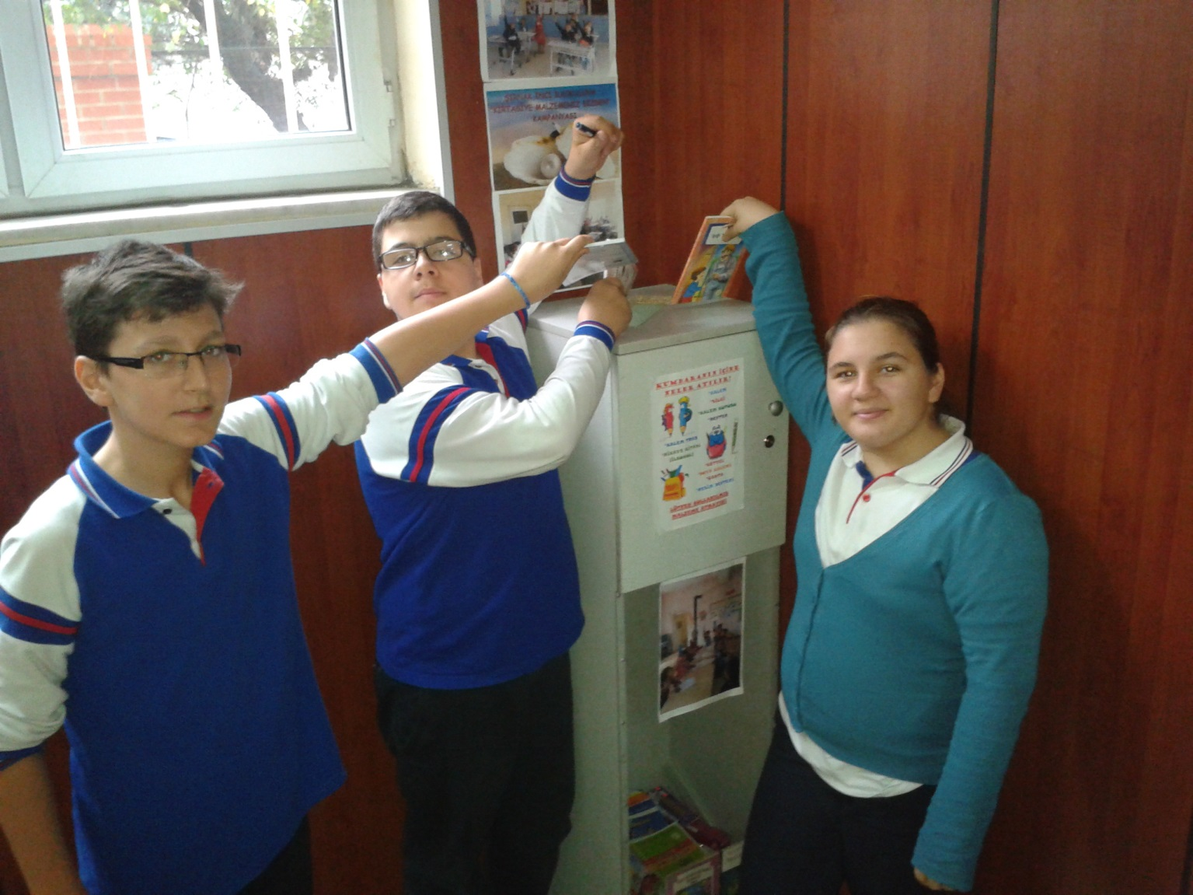

Slide 8
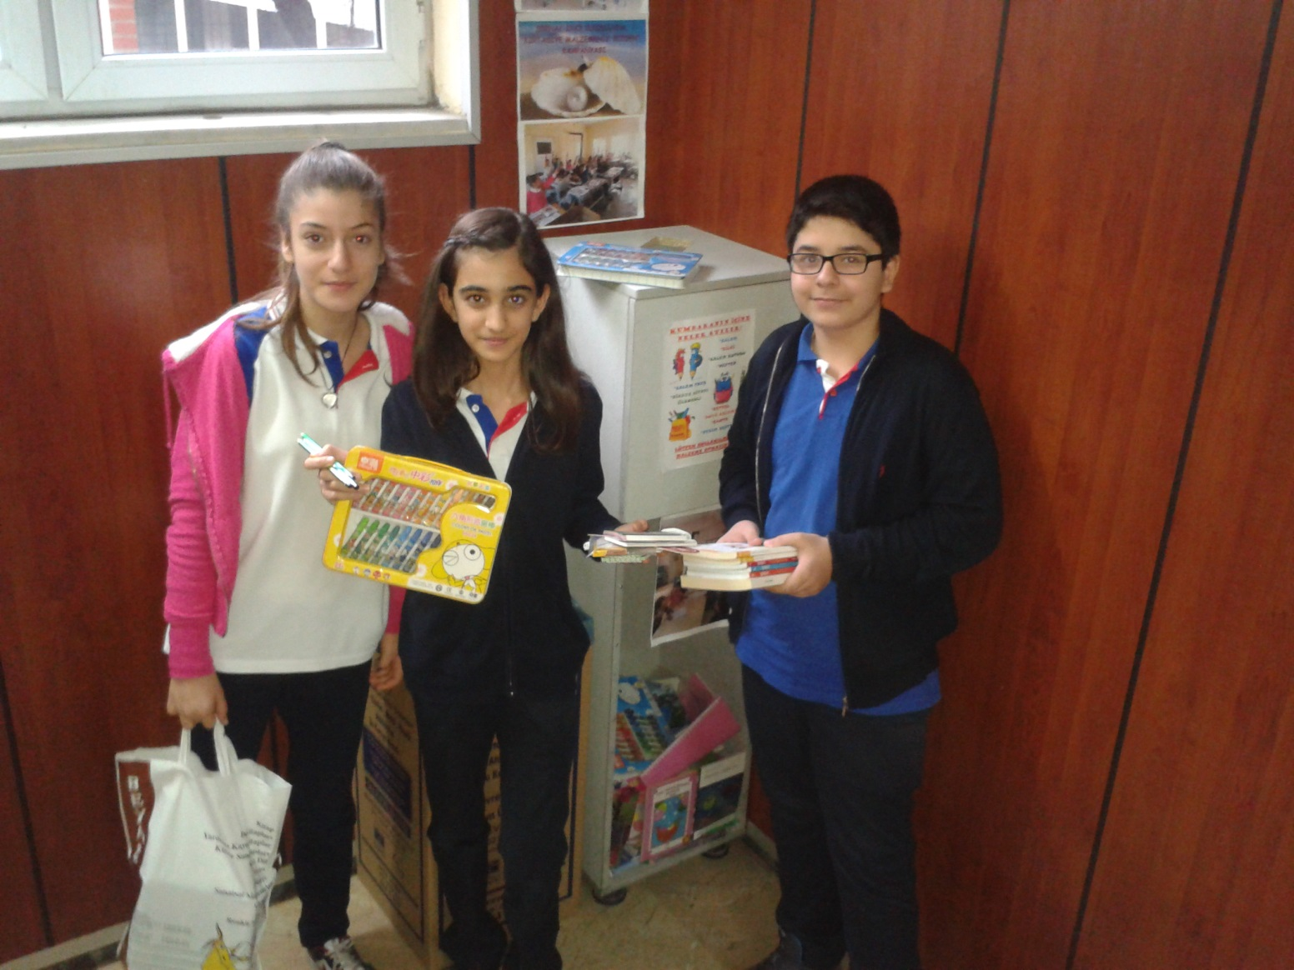

Slide 9
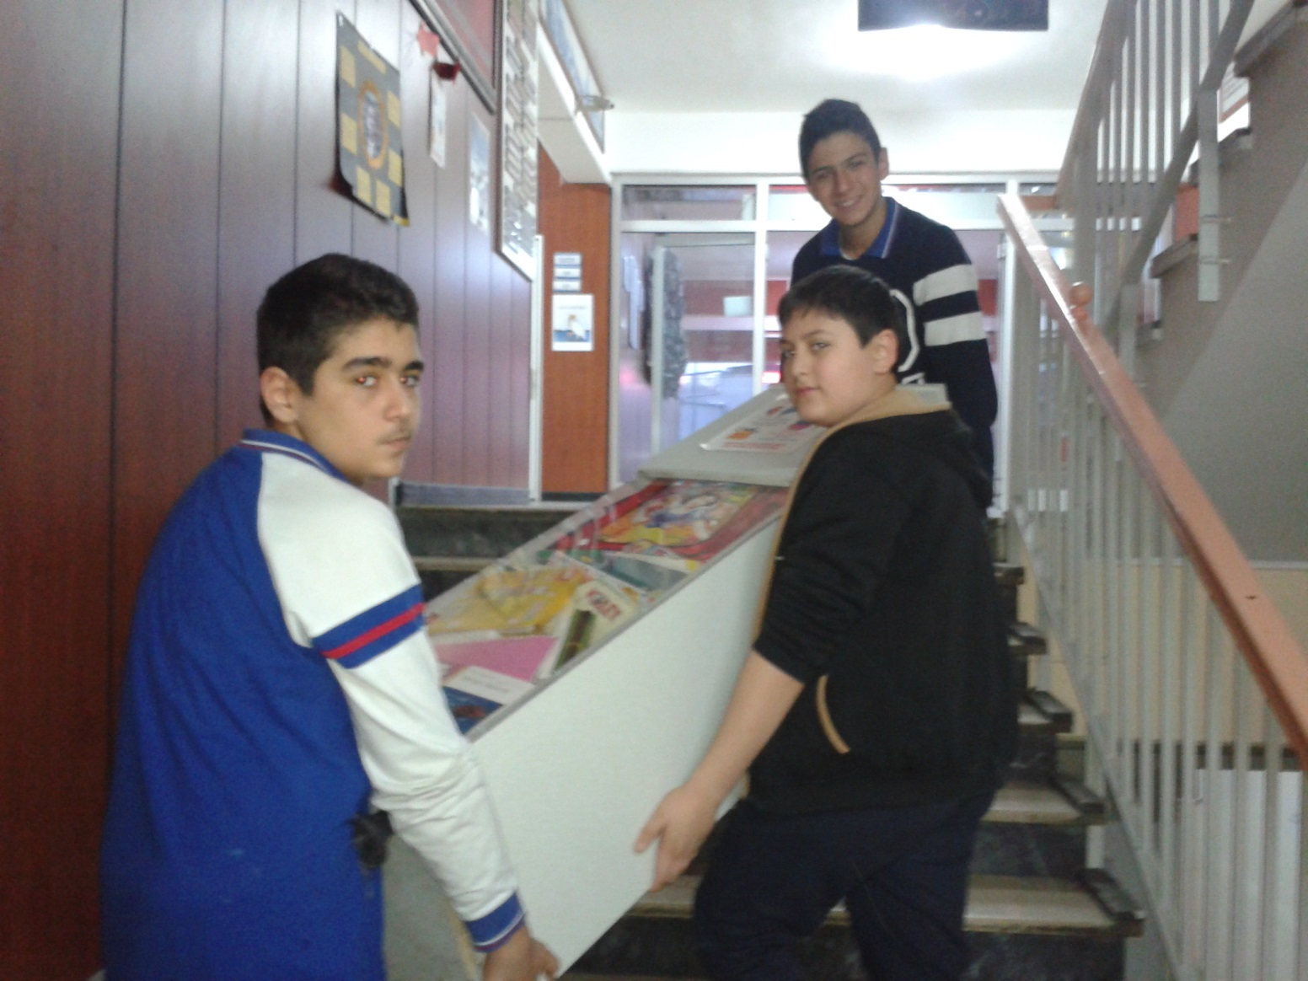
Almost every two weeks it was full and it was time to reload it

Slide 10
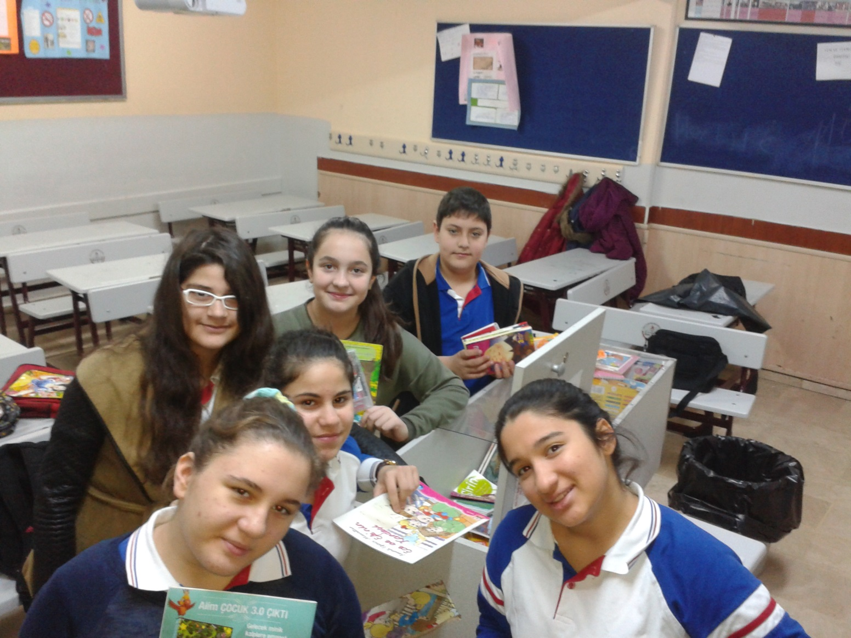
Every one cooperated for their sisters and brothers who live in Sırnak, Eastern Turkey

Slide 11
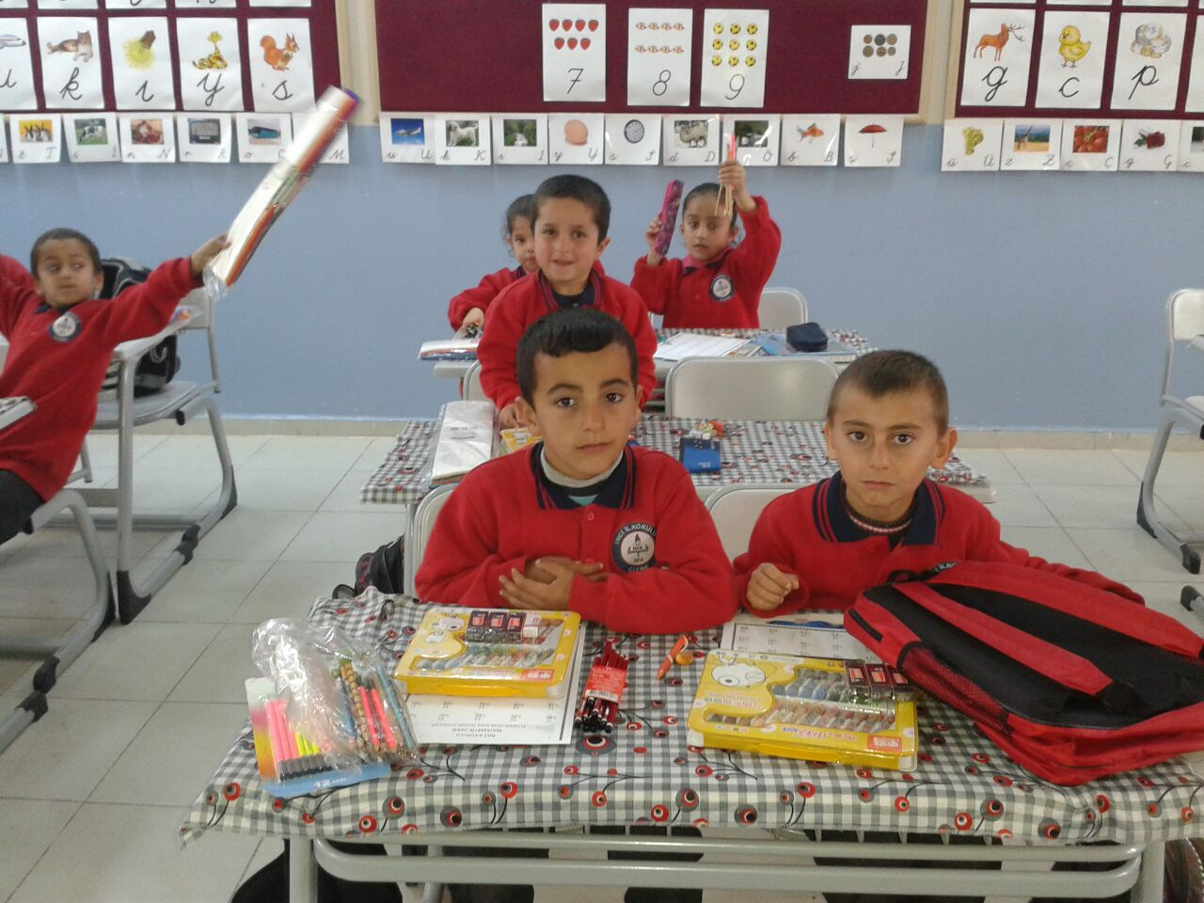
And happy moments …

Slide 12
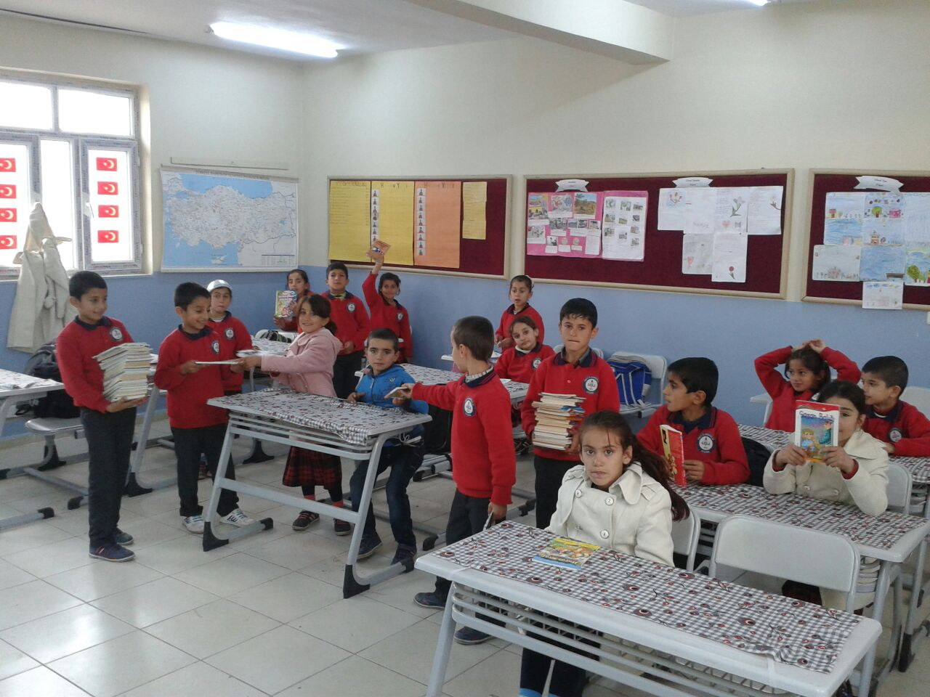
When we learnt how happy they became, we were the happiest ones in the world.

Slide 13
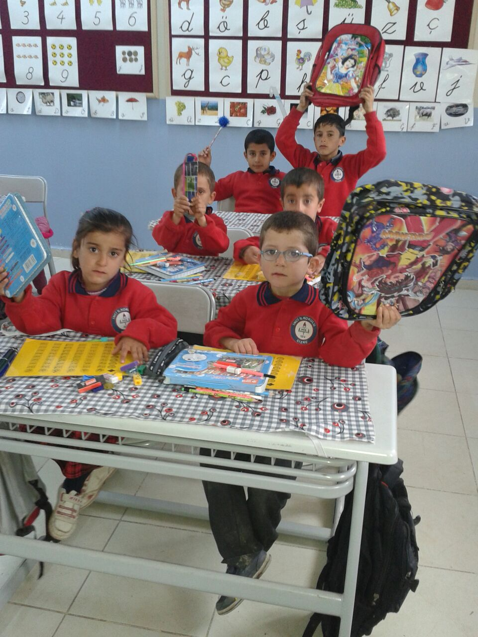

Slide 14
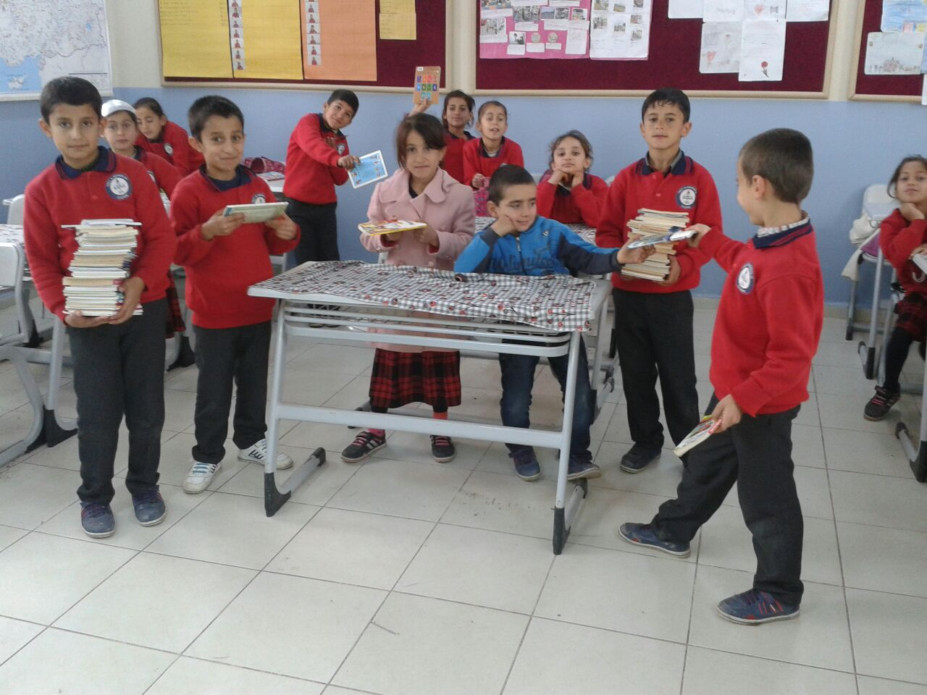
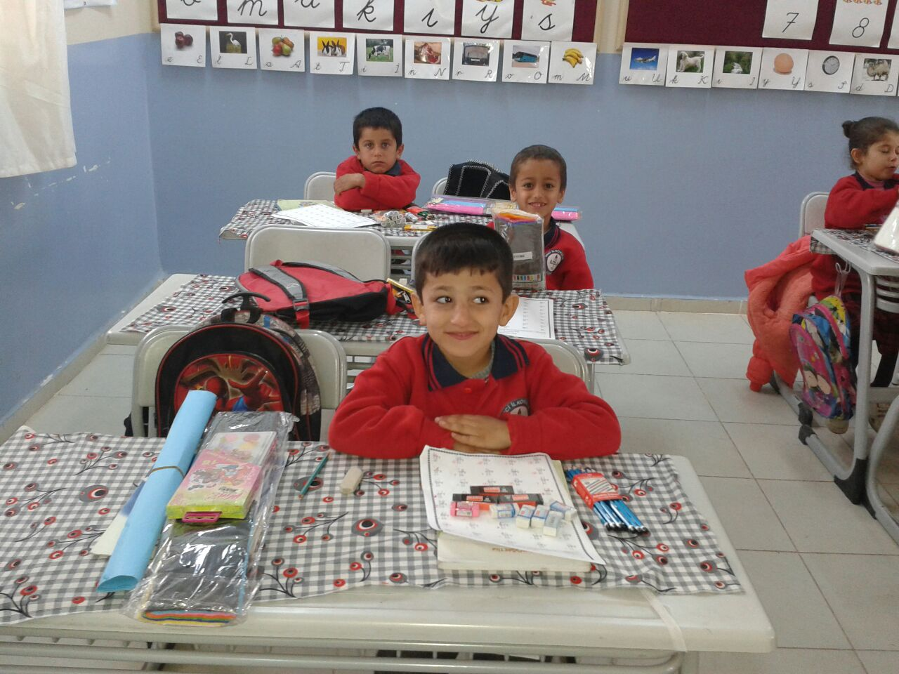

Slide 15
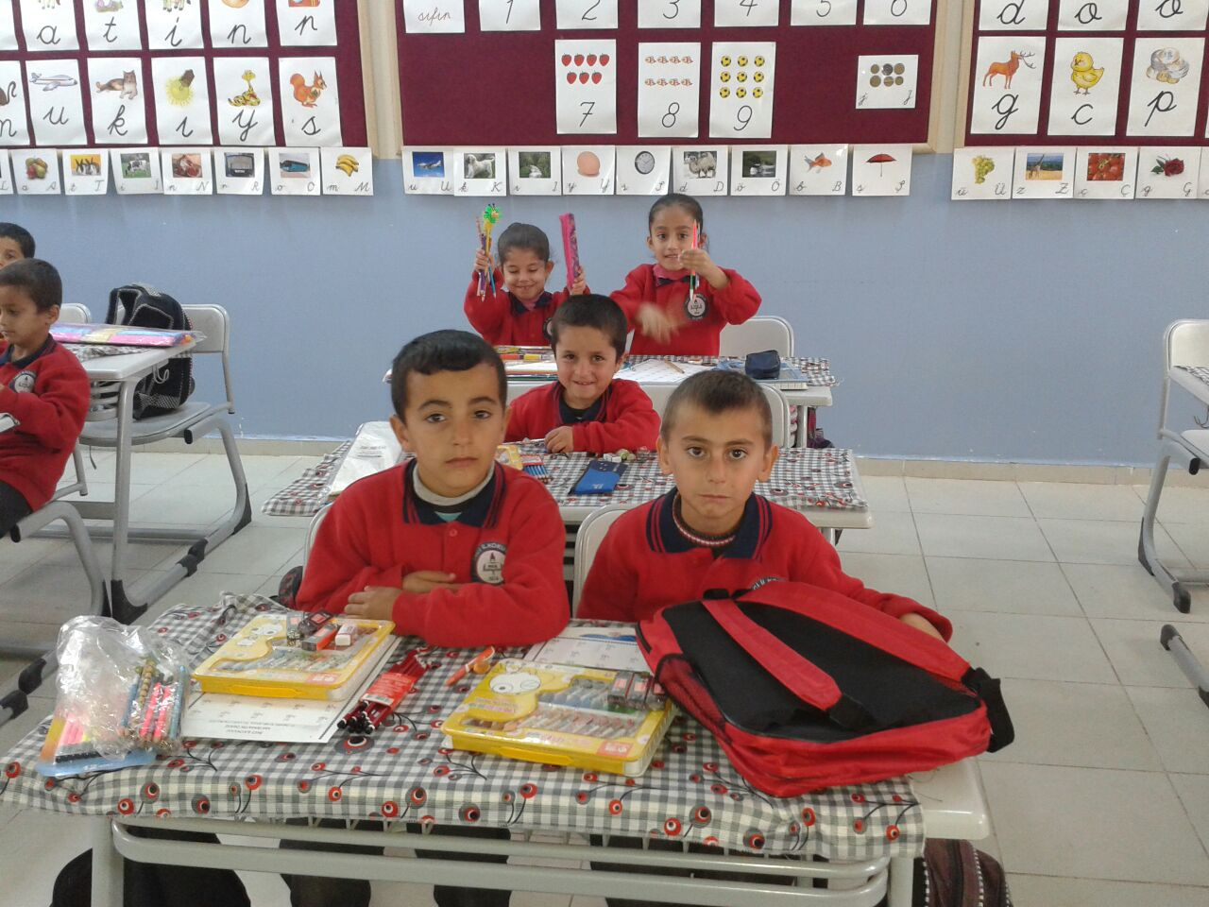

Slide 16
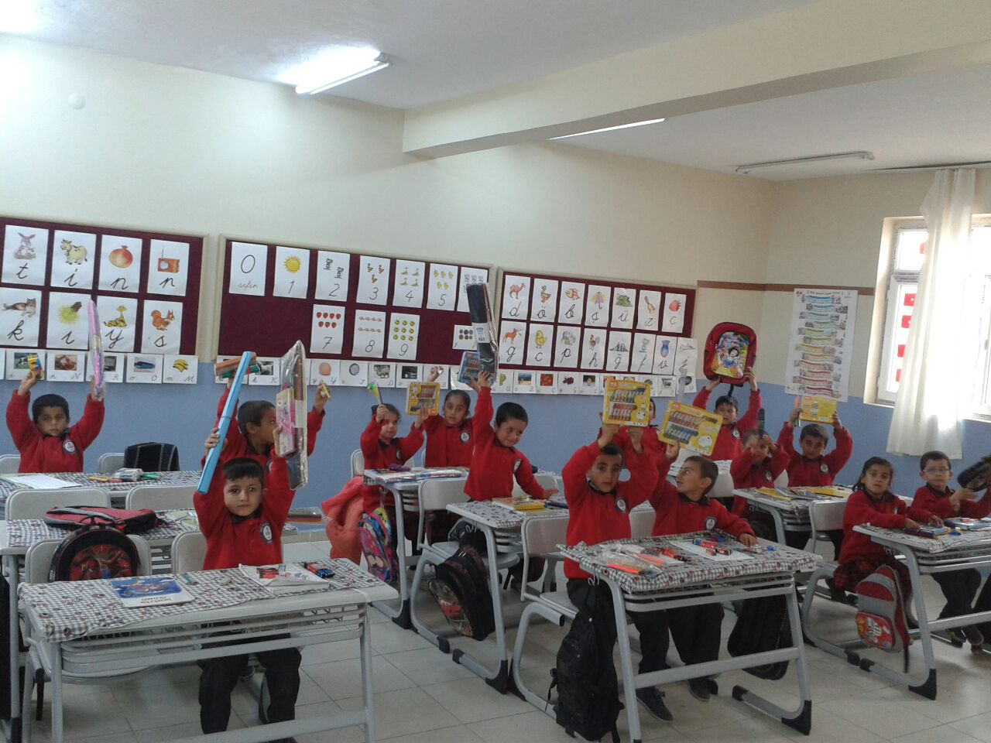
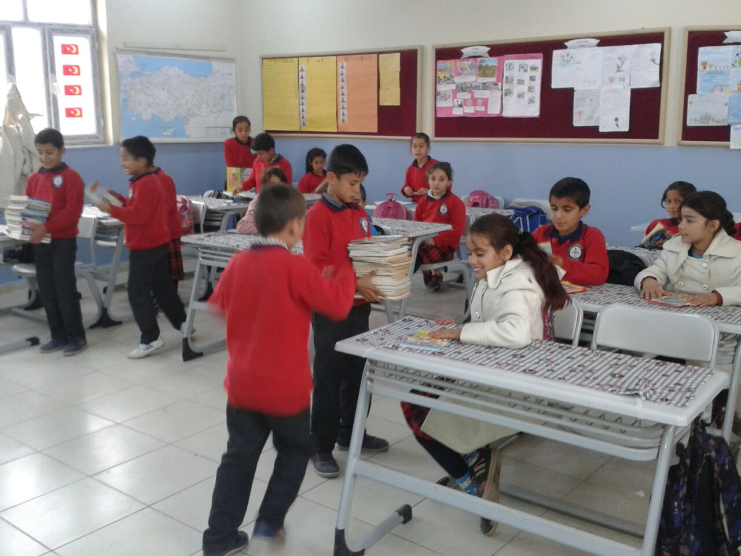

Slide 17
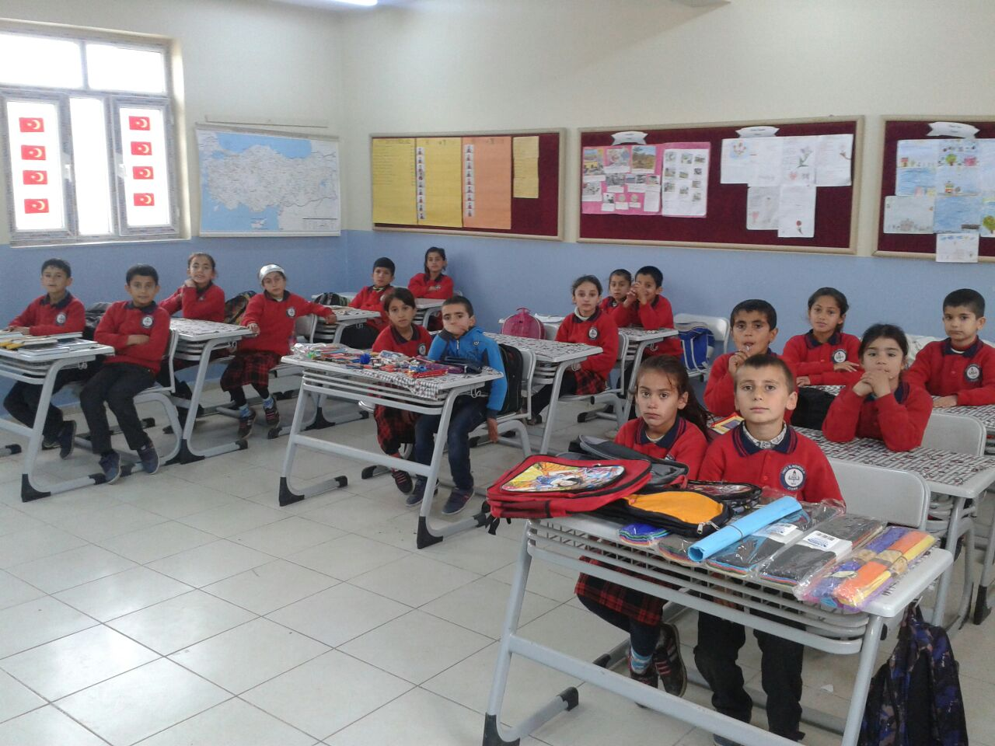

Slide 18
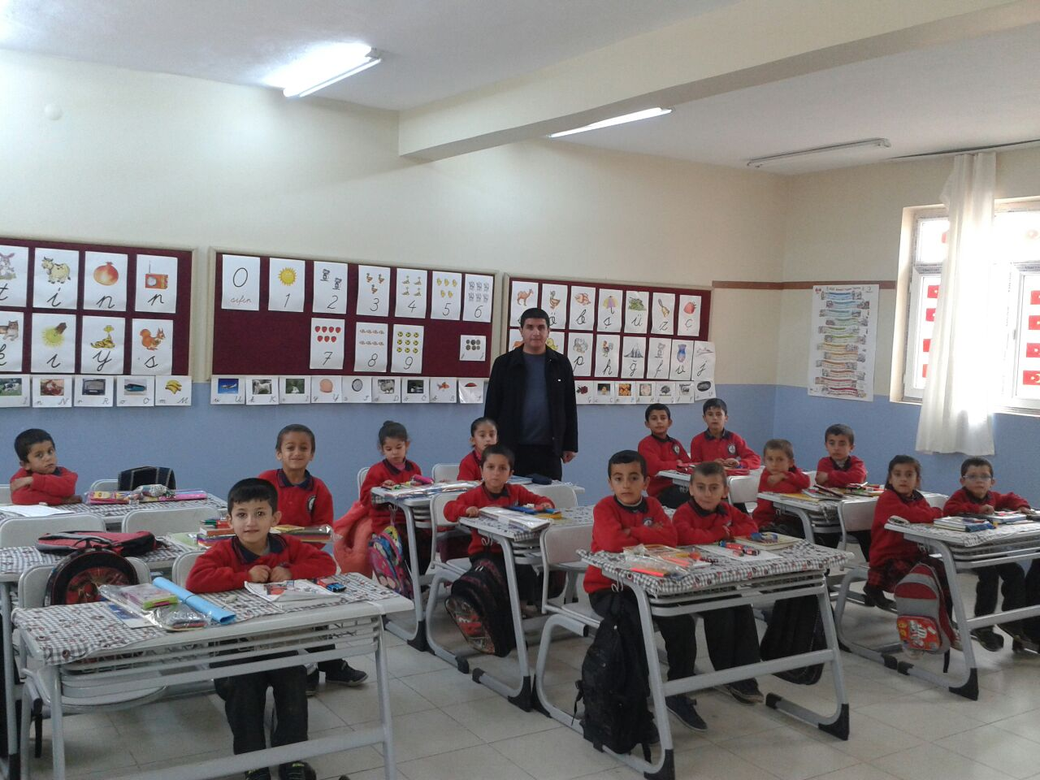
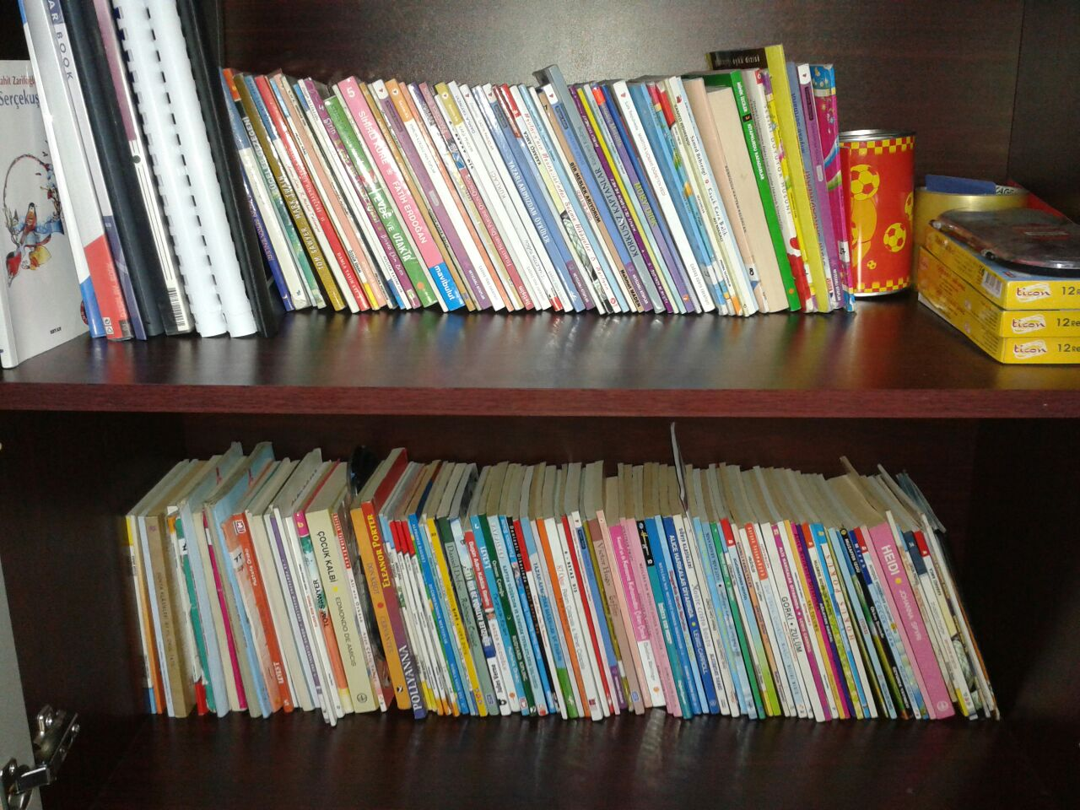
They said they had a library with the books we sent them and gave its name Kumport Secondary School
Gönderdiğimiz hikaye kitaplarıyla sınıf kitaplığı oluşturmuşlar.

