Slide 1
TURKISH CHARITY
As Kumport Secondary School, we came together for or friends in Africa. We prepared some works inspired by our Erasmus partners.

Slide 2
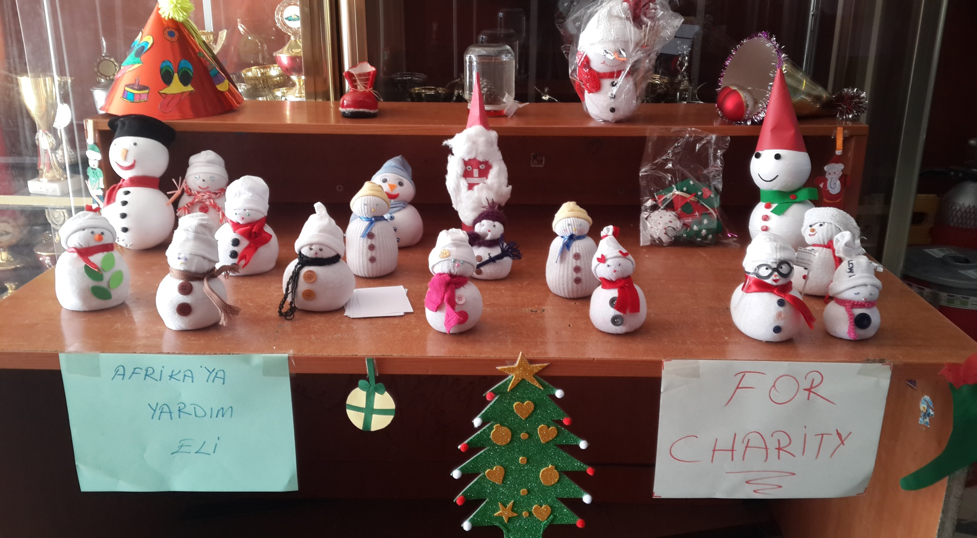
We opened a stand at the entrance of our school.
We

Slide 3
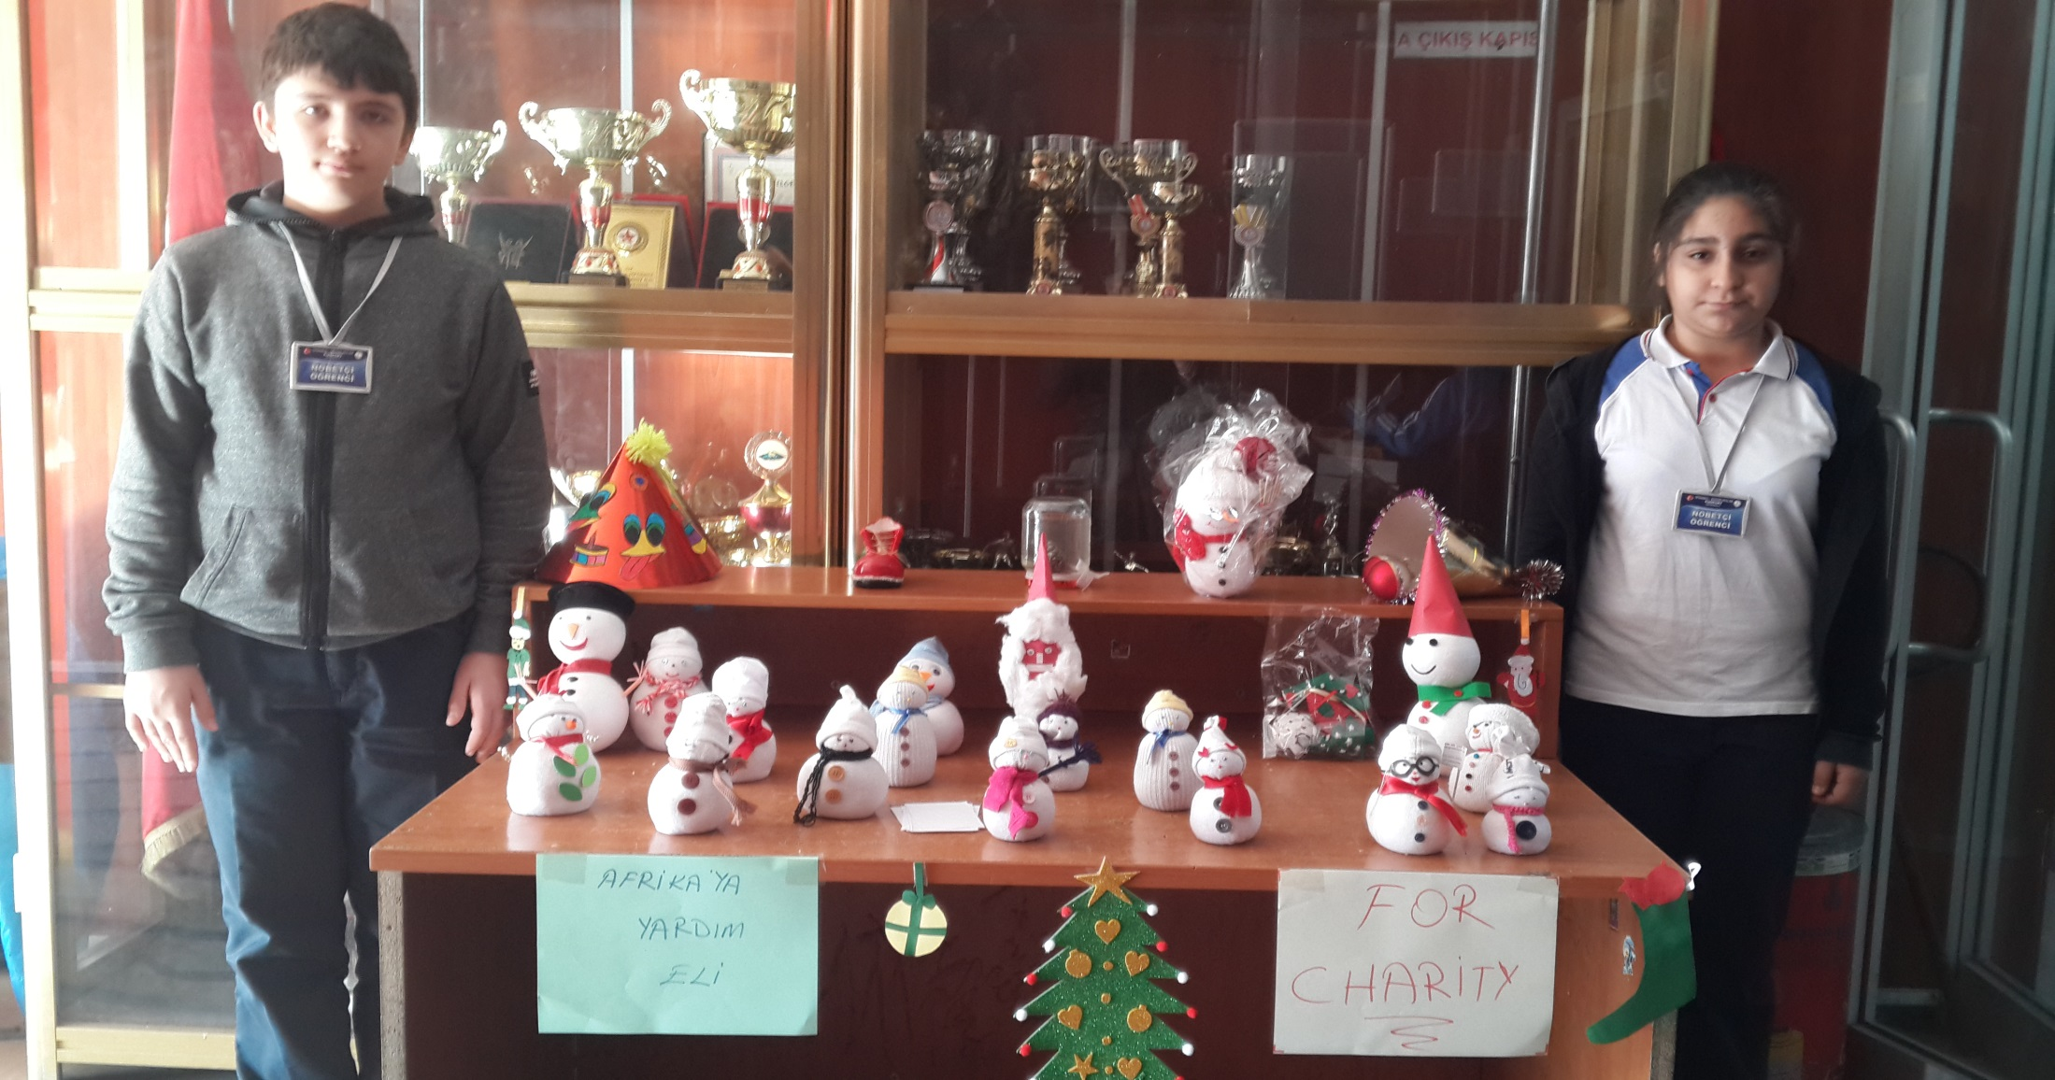
Our two friends were the responsibles to sell

Slide 4
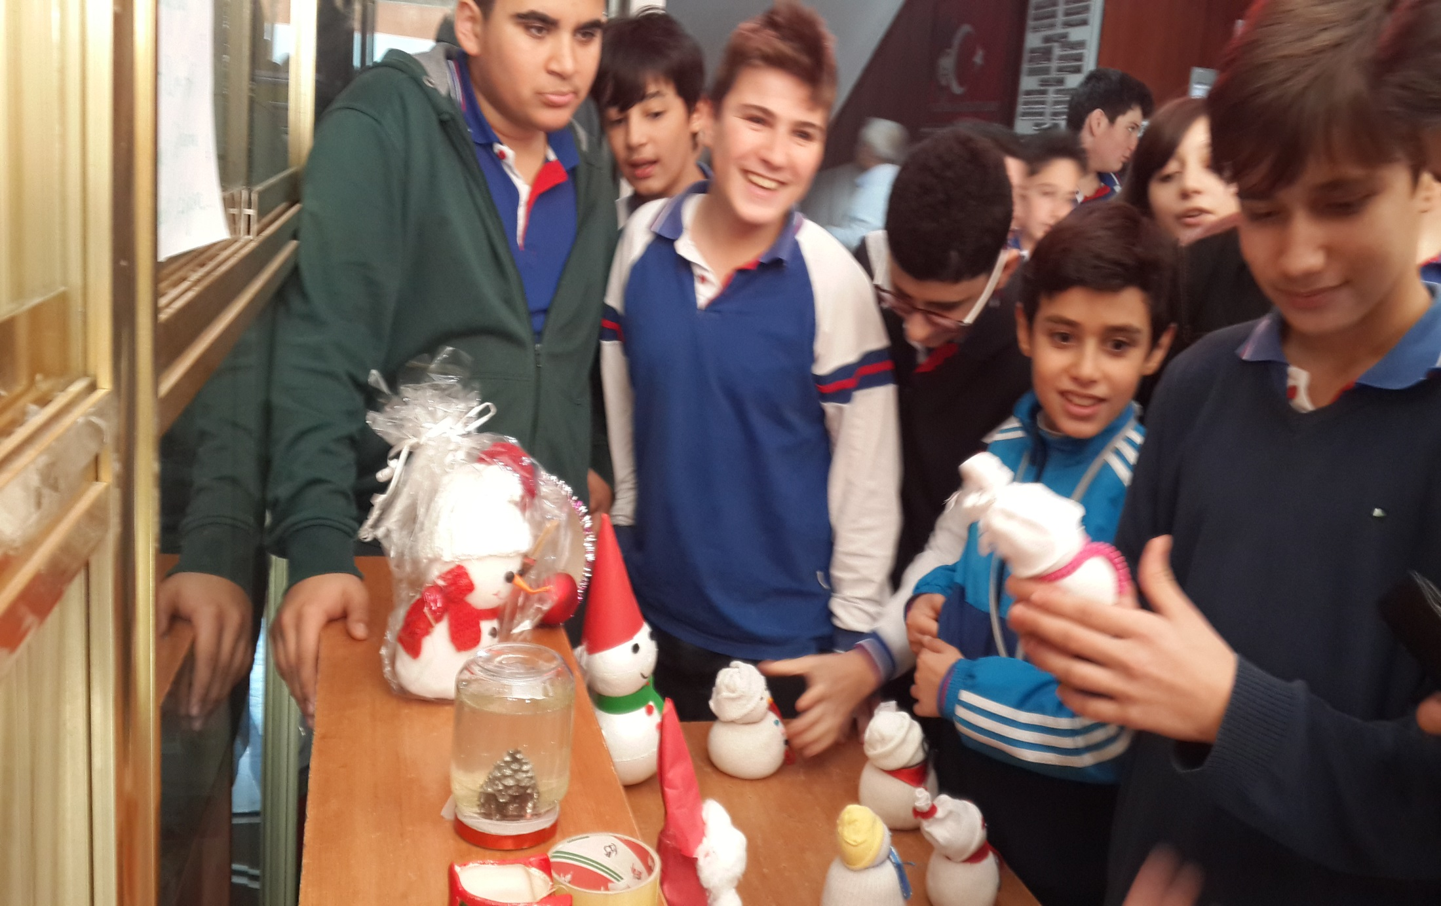
The interest was so big.

Slide 5
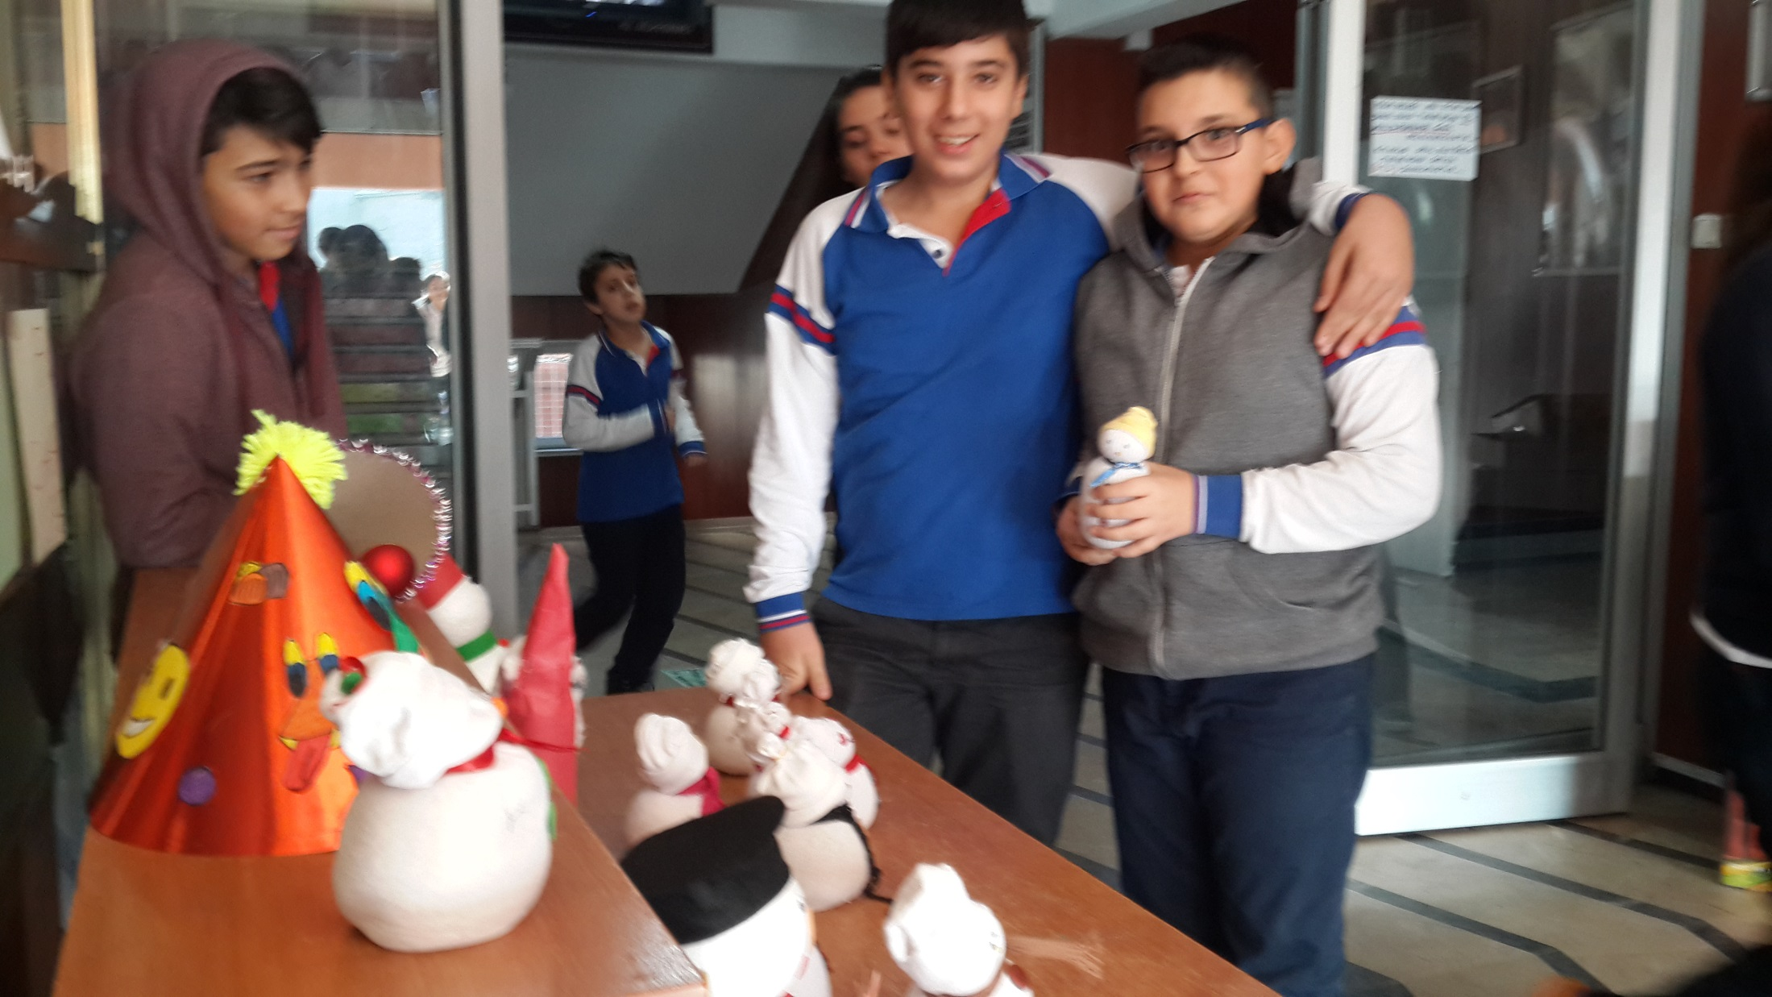
We collected 100 Turkish liras.

Slide 6
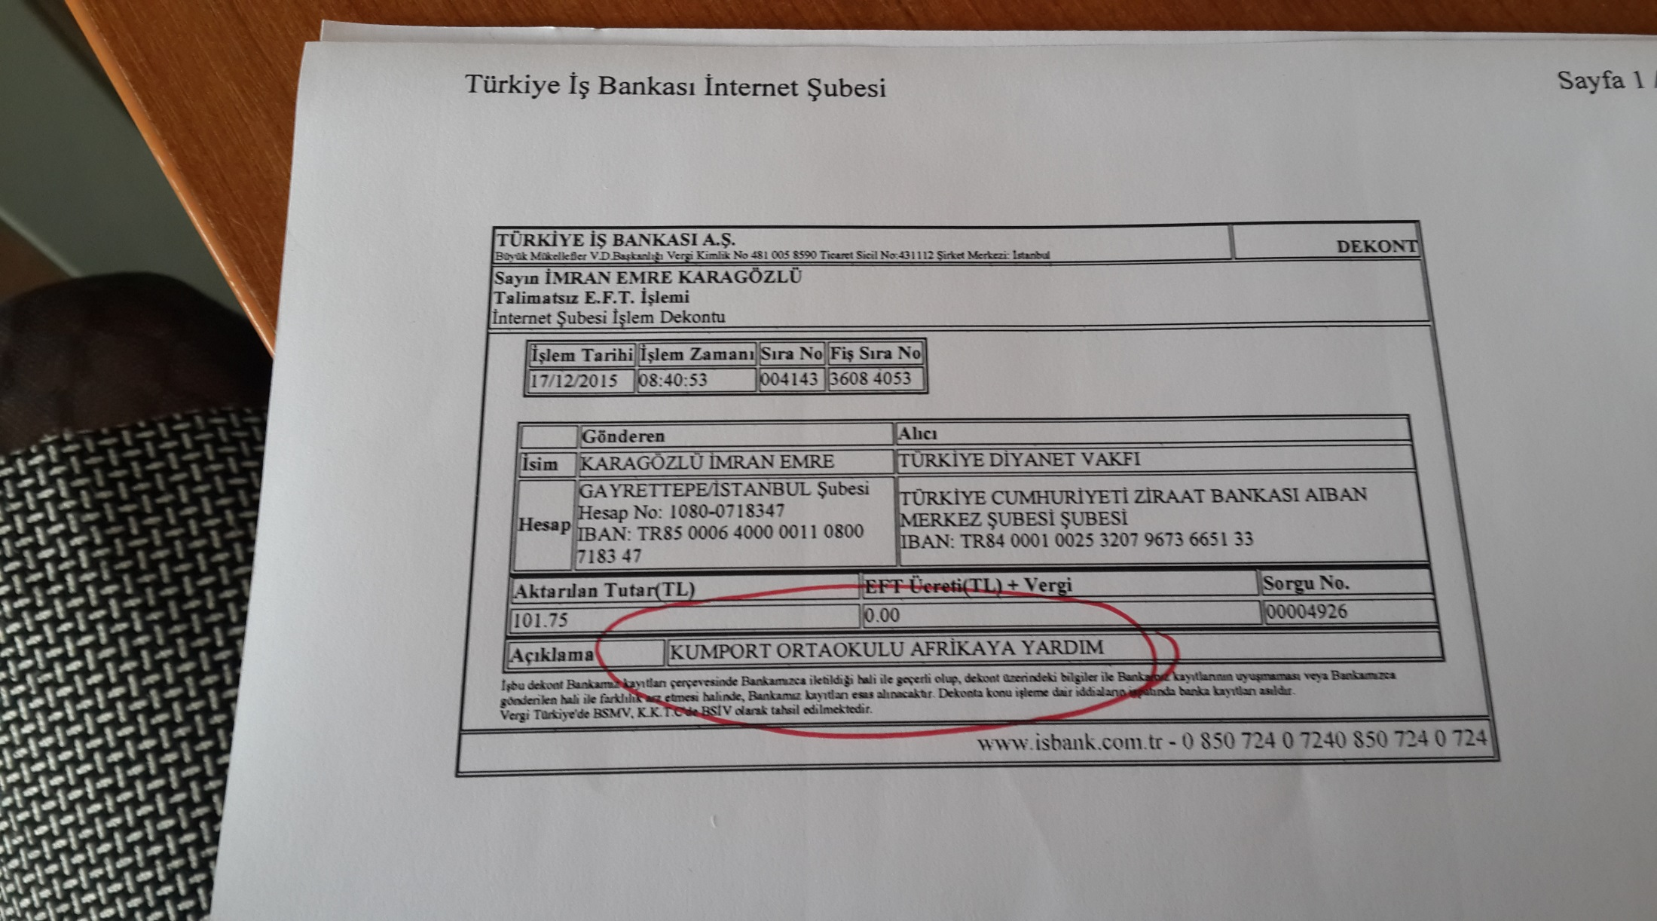
We transferred the money we collected. This is the receipt. We are very happy to hold their hands.

