Slide 1
SCHOOL COUNCIL
FEBRUARY

Slide 2
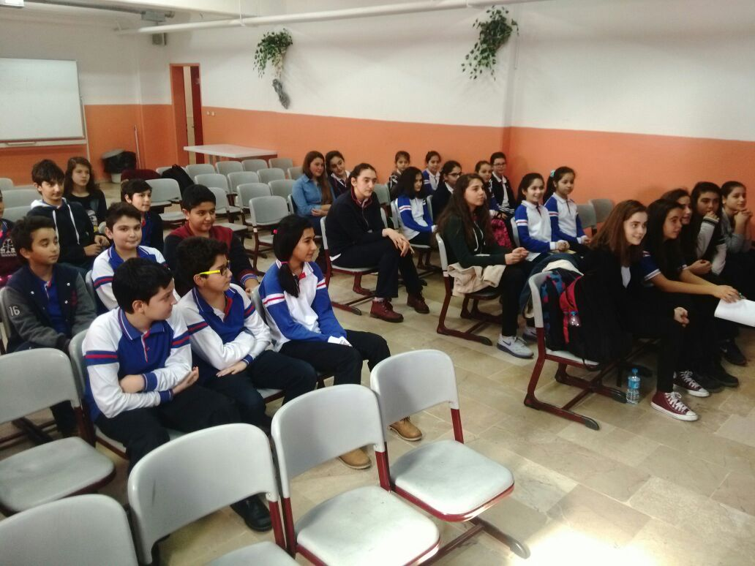
Our school council had a meeting in February again.Each representative of the classrooms came together to discuss the issues about our school.

Slide 3
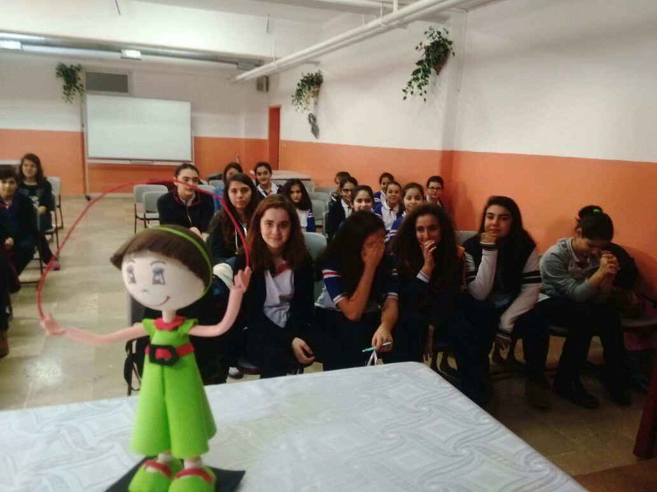
Our lovely Czech mascot Labenka was there to witness the promises given by the management.

Slide 4
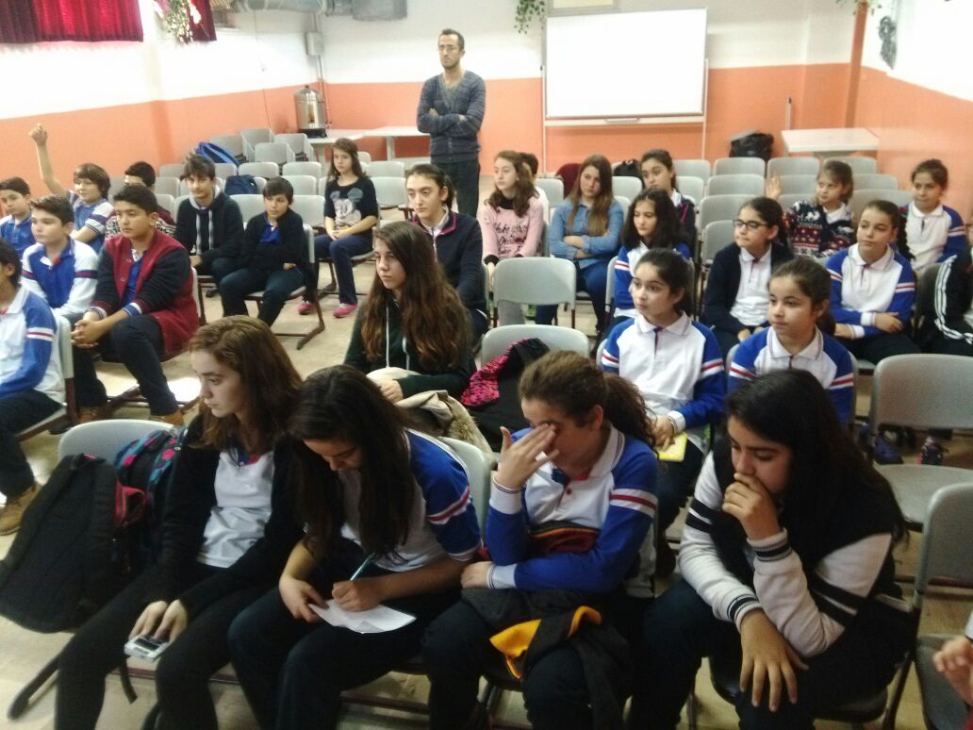
The issues spoken during the session were about the charity events hold in the school.

Slide 5
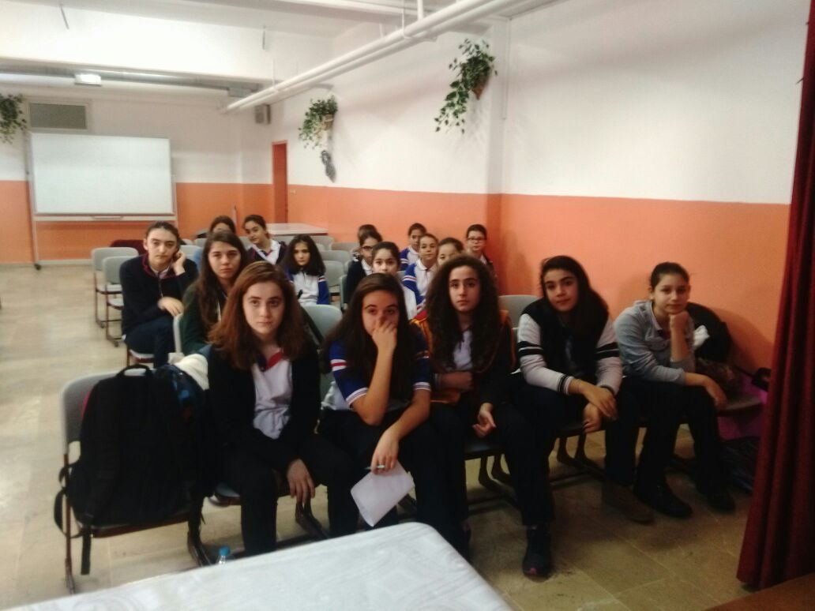

Slide 6
BAHÇELİEVLER
CHILDREN’S COUNCIL

Slide 7
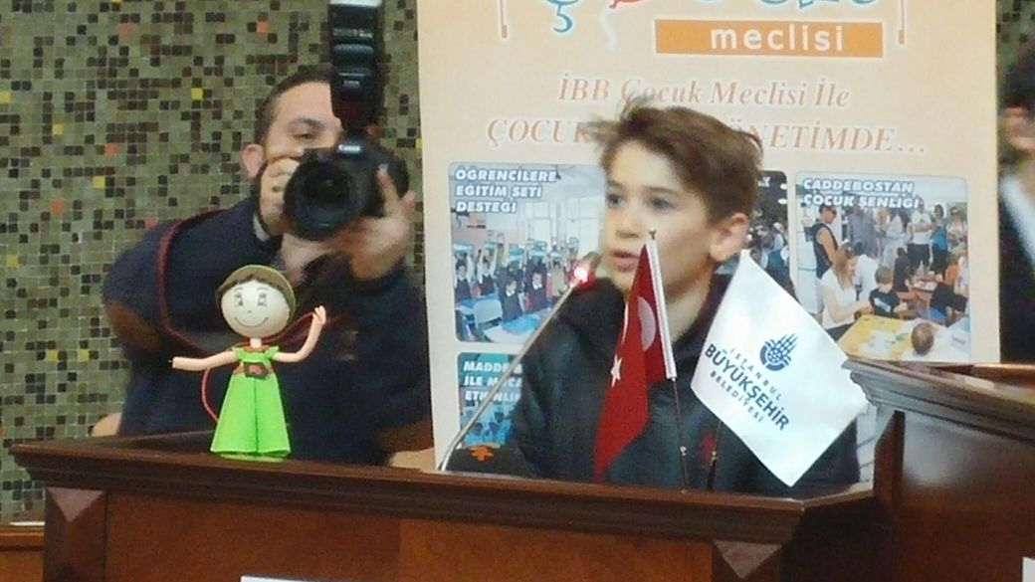
February was an important month for us as we would attend to the first Children’s Council of Turkey. The name of the council is Municipality of Bahçelievler Children’s Council.

Slide 8
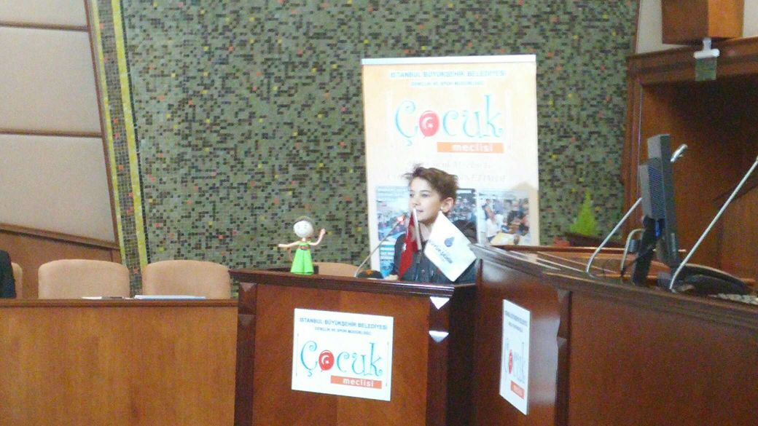
Berkay was chosen as the lucky student who would live this pride. He delivered a very meaninful speech to encourage his peers about the issues related to the rights of children.

Slide 9
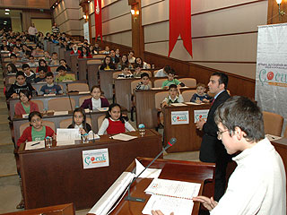
The first decision taken by the council was to help their friends who live in a village in Hakkari, eastern Turkey. Books, stationery equipments and clothes would be sent to them.

Slide 10
